Slide 1
INNOVATIVE MANAGEMENT CONSULTANTS
IMC - IS A (NGO), REGISTERED UNDER THE TRUST ACT
MAIN FOCUS AREA IS MSME’S EMPOWERMENT AND START-UP INCUBATION
Admn. Office:
South Square Bldg., Manorama Jn.,
Panampilly Nagar, Cochin.
E-mail: imcindia2016@gmail.com

Slide 2
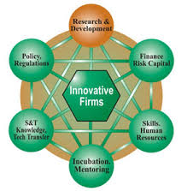
CLUSTER DEVELOPMENT
A cluster is a local agglomeration of enterprises (mainly SMEs) which produce and sell similar or related products.
Its purpose is to promote economic development of specific business sectors and MSME.

Slide 3
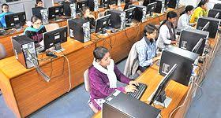
SKILL DEVELOPMENT
Skill development is necessary to improve productivity in the workplace and the competitiveness of our business and to improve quality of life of workers.
A distinction between education, training and skill development need a framework with clean objectives.

Slide 4
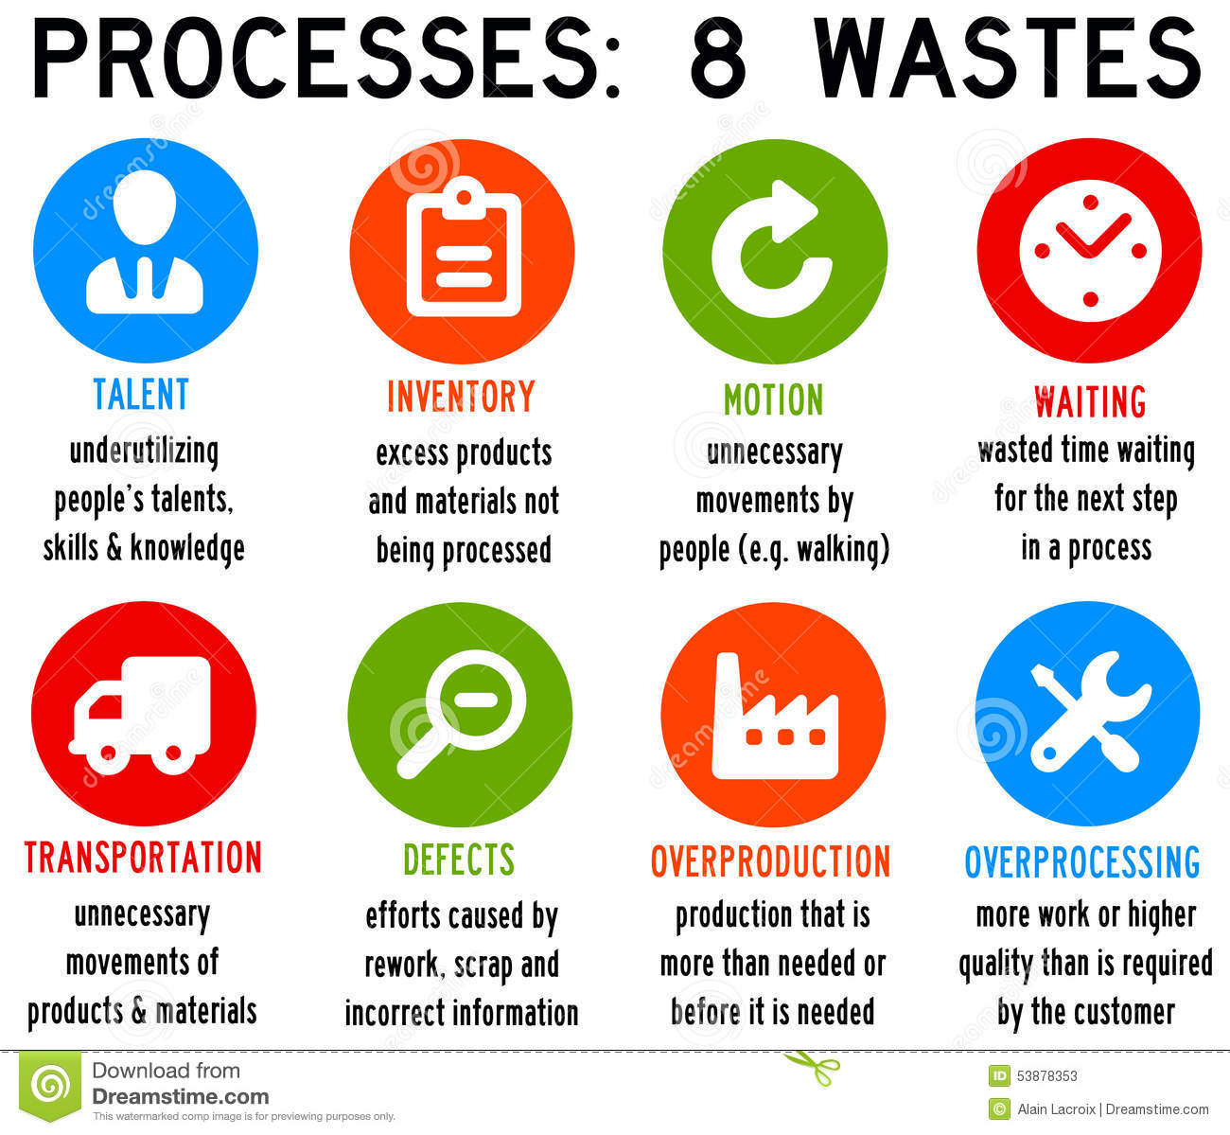
LEAN MANAGEMENT
Eliminating waste along entire value streams instead of at isolated points, creates processes that need less human effort, less space, less capital and less time to make products.
This helps in reducing costs and with much fewer defects, compared with traditional business system.

Slide 5
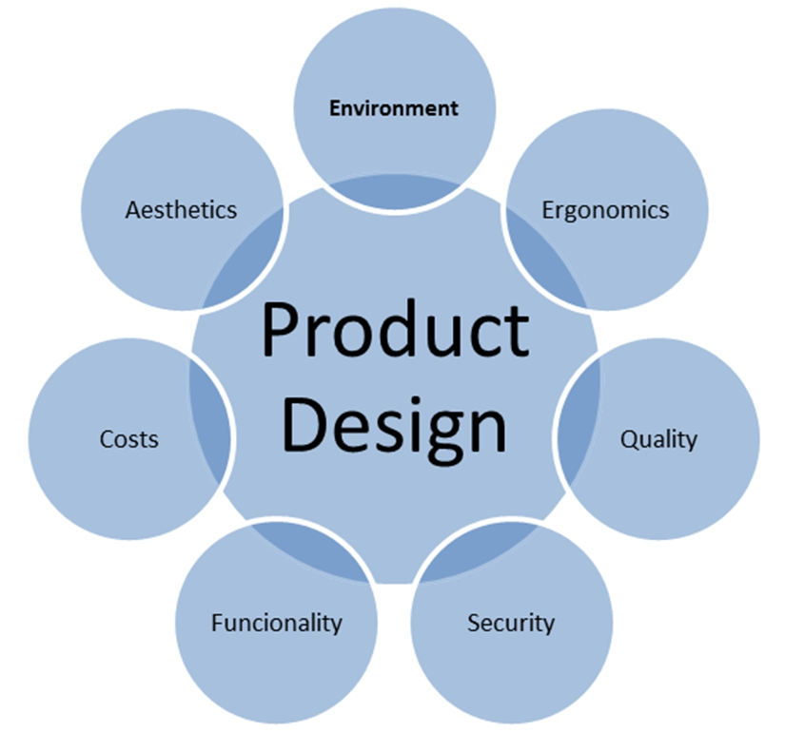
DESIGN CONSULTANCY
(Design Incubation Studio)
Invest in Design and Make more Profit
Design processes is the set of technical activities within a product development process.
Product development process is the entire set of activities required to bring a new concept to a state of market readiness.

Slide 6
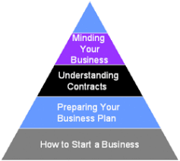
Entrepreneurship Development
Identify what impacts productivity in your business, both positively and negatively.
Review your competitive position
Identify what differentiates you from your competitors.
Where do your competitors have the advantage and what skills need to be developed to mitigate these risks.

Slide 7
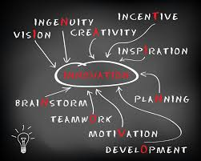
INNOVATION
The process of transforming an idea or invention into a good product or service that creates more value for which the customer will pay
It is the successful exploitation of new ideas using new technologies and design that enables business to compete effectively in the emerging global environment

Slide 8


GREEN BUILDING
Promotion of Eco Friendly Green Building concept by using the plantation wood, coir wood, coconut wood, palm wood and rubber wood.
All this is done as a part of our social commitment towards reducing global warming.

